Slide 1
Deep learning cooking recipe
High bias (train-val loss similar but high):
Build bigger NN
Train model longer
Use better optim algorithm
High Variance (train loss low val loss high):
Get more data (augmentation or sythesis)
Add regularization (L1, L2, LF)
Change architecture or search for better hyperparams
Add normalization for faster convergence

Slide 2
Conv layer
For a 2d conv layer with size f, padding p, and stride s output is:
Maxpool layer
For a maxpool layer with size f and stride s output is:

Slide 3
RNN
a^{<t>} = g₁(W_{a}*[a^{<t-1>}, x^{<t>}]+b_{a})
Where W_{a} = [W_{aa}|W_{ax}] and [a^{<t-1>}, x^{<t>}] = [a^{<t-1>} / x^{<t>}]
ỹ^{<t>} = g₂(W_{y}*a^{<t>} + b_{y})
GRU
ĉ^{<t>} = tanh(W_{c}*[c^{<t-1>}, x^{<t>}] + b_{c})
Γ_{u} = sigma(W_{u}*[c^{<t-1>}, x^{<t>}] + b_{u})
c^{<t>} = Γ_{u} * ĉ^{<t>} + (1- Γ_{u}) * c^{<t-1>}
Where * is element wise and memory can be a vector

Slide 4
Full GRU
a^{<t>} = c^{<t>}
ĉ^{<t>} = tanh(W_{c}*[Γ_{r}*c^{<t-1>}, x^{<t>}] + b_{c})
Γ_{u} = sigma(W_{u}*[c^{<t-1>}, x^{<t>}] + b_{u})
Γ_{r} = sigma(W_{r}*[c^{<t-1>}, x^{<t>}] + b_{r})
c^{<t>} = Γ_{u} * ĉ^{<t>} + (1- Γ_{u}) * c^{<t-1>}
Where * is element wise and memory can be a vector
BRNN
ỹ^{<t>} = g(W_{y}[a_{f}^{<t>}, a_{b}^{<t>}] + b_{y})

Slide 5
LSTM
ĉ^{<t>} = tanh(W_{c}*[a^{<t-1>}, x^{<t>}] + b_{c})
Γ_{u} = sigma(W_{u}*[a^{<t-1>}, x^{<t>}] + b_{u})
Γ_{f} = sigma(W_{f}*[a^{<t-1>}, x^{<t>}] + b_{f})
Γ_{o} = sigma(W_{o}*[a^{<t-1>}, x^{<t>}] + b_{o})
c^{<t>} = Γ_{u} * ĉ^{<t>} + Γ_{f} * c^{<t-1>}
a^{<t>} = Γ_{o} * tanh(c^{<t>})
Where * is element wise and memory can be a vector
ỹ^{<t>} = softmax(a^{<t>})

Slide 6
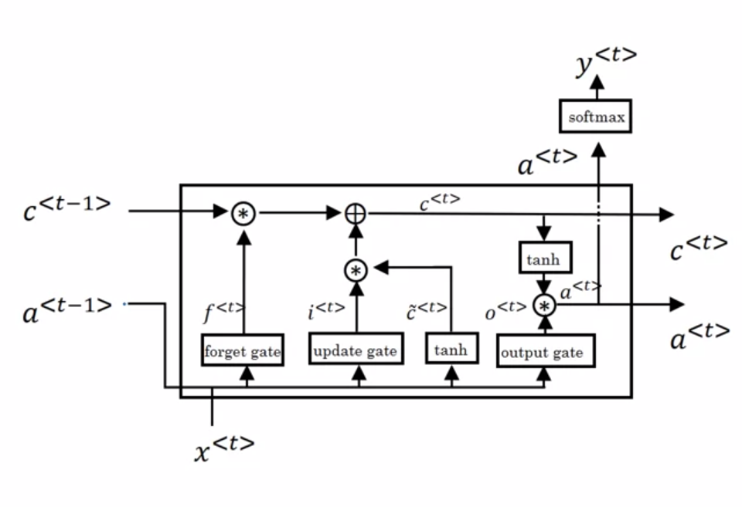

Slide 7
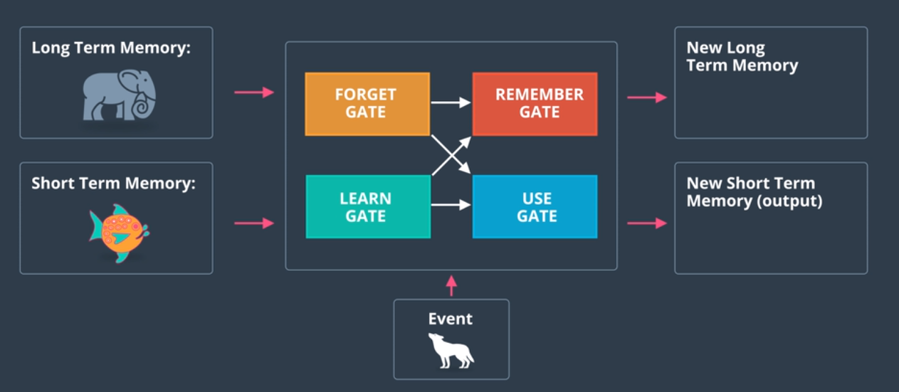

Slide 8
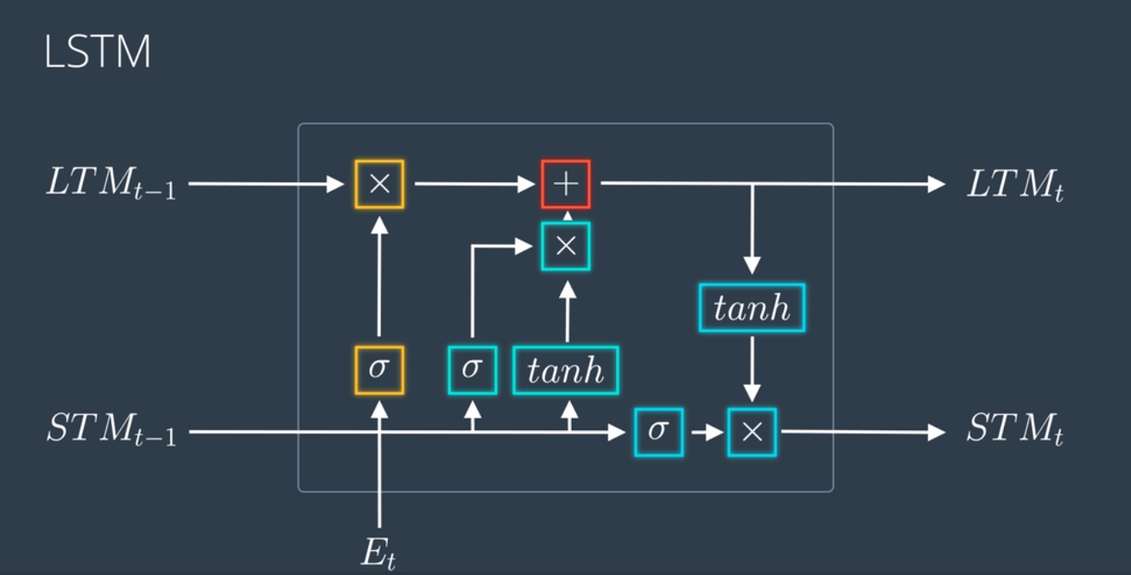

Slide 9
